Slide 1


Bank of Baroda Hackathon - 2022
Technology Partner
Your Team Name : AI-Hackers
Your team bio : A visionary team led by a Principal data Scientist ( Msc Statistics & Master Programme in AI) having 16+ years of experience in Data science & AI and also have 3 more Sr data Scientist ( MSc Statistics & Mtech in data Science )from various leading IT MNCs. The lead has prior history of winning various Global Data science Hackathon.
Date :20th Sep 2022

Slide 2
Problem Statement?
Why did you decide to solve this Problem statement?
Artificial Intelligence is the future of banking as it brings the power of advanced data analytics to combat fraudulent transactions and improve compliance. AI brings the power of data to make a platform to make decisions which are much advanced than a human brain.
Our deep knowledge in Statistics and Computer Science which would help us to build an AI platform for BOB in Video Analytics to make banking much easier for both management and customer as well.
The benefit which can be provided by this solution as mentioned below :
1) Fraud detection and Bank Safety:
By using CCTV footage ,we can build video analytics to improve bank safety by identifying any adverse situation in the bank premises.
The solution would help to prevent any suspicious or unwanted activities/ objects captured in the bank premises.
The solution would try to figure out the customers who are spending more time in premises unnecessarily.
This solution can be also used in ATM to capture and send alert if any person enters with mask or doing some suspicious activity
We also have plan to build some alert mechanism to handle these adverse situations in the bank premise .
2) Customer Satisfaction:
By using facial expressions, the solution will try to find out the sentiment of the customer
The system should be able to find out the customer's happiness , sadness ,anxious or other level of human feelings to find the sentiment of a customer. This would help to improve customer service.
Video KYC service also can be planned to implement using customers images stored in the database and use face similarity cognitive services.
manage it with database
3) Bank revenue generation:
By predicting the unique customers visiting in the branch on daily/ weekly basis, we can try to predict the footfall of that branch which might help the bankers to manage customer service better and also indirectly helping revenue generation.
The system should be able to capture the radiance customer or high net worthy customer which would help to give premium service to their problem.
Create alert for new customers in the premises and give more importance with the banking products available on which they will be interested.
We believe the above services are a serious concern to the bankers where AI can help them to build a smart solution to reduce the human intervention, reducing time ,improve customer satisfaction, bank on premise safety , fraud detection and revenue generation as well. To provide this solution, we have planned to use Azure cognitive services to build a cost effective and highly accurate AI solution for BOB.

Slide 3
User Segment & Pain Points
Which user /advertiser segment would be early adopter of your product & why?
The AI Solution that has been planned for BOB would be really a game changer in Banking Solutions. We believe that the early adopter of our solution would be as mentioned below :
1) The Banking Staff :
We have planned to implement some alert mechanism for on premise banking stuff to handle in any suspicious activity as mentioned in slide no 1
We can also plan detect customers spending more than 25 minutes in the premises. It will help in security purposes.
Alert mechanism to auto trigger while entering any radiance customer in the banking premise.
2) The Bank as an organization :
We can also try to figure out the new customers who are suddenly visiting the premises frequently and also trying to visit the sensitive areas. This way we can figure out any suspicious activities in prior.
Get an insight on an average the unique customers visiting the bank to understand the customer footfall.
Bank will be benefitted from fraud and safety and also getting insight to increase revenue generation by creating AI based secure environment with high customer satisfaction.
3) The customers :
From this AI solution , the customer will be also benefitted to get a good and quick hassle free service in a secure environment.

Slide 4
Pre-Requisite
There are many alternative products with use cases like, Monitoring, Theft protection, Surveillance and etc. in various businesses. Some of these products are:
Health care:
The University at Buffalo developed a smartphone application designed to help detect autism spectrum disorder (ASD) in children.
Retail:
Marine Layer is a clothing retailer headquartered in San Francisco that deployed an intelligent video analytics solution to gain insights about customer traffic in their stores.
Traffic and City Management:
In order to better understand major traffic events, the New York City Department of Transportation used video analytics and machine learning to detect traffic jams, weather patterns, parking violations and more.
Banking and ATM:
BriefCam transforms video into valuable insights for rapid video review and search, as well as patented VIDEO SYNOPSIS technology; real-time alerting; and quantitative video insights. They serve many domains including Healthcare and Banking.
Agrex provides video analytics for bank atm machines and restaurants. It checks various use cases like If the machine is working or not. If the shutter is down. Keep a check on camera tampering etc.
AllgoVision works in traffic Surveillance, Building Surveillance, City Surveillance, Business Intelligence across different Sectors. And for banking They are working with SBI and Kotak Bank.
Cronj is the company that provides theft protection in banks,

Slide 5










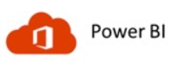
Azure tools or resources
2. Analyze Data
Azure Video Indexer
Bank Database
Storage Account
Azure MLOps Development in future
Storage Account
Output
Build Prototype Model
Model Prodictionalize
Container Registry
Productionalize
Azure DevOps
Model Deployment
Mode monitor and Retrain l
Create Alert
Insights
Interactive Dashboard

Slide 6
Azure tools or resources
Azure Resources to be used are:
1) Azure Cosmos DB 2) Azure IOT Hub 3) Azure Video Analyzer for Media 4) Azure Stream Analytics 5) Azure Cognitive Services like computer vision, custom vision.. 6) Microsoft Power BI
Notes: 1) Transfer Learning process can be used to customize the models using the Azure Video Indexer website or API 2) Based on particular business requirement video can be converted to images and custom CNN or any deep leaning models Tensorflow object detection models models
3) The solution and resources will be optimized based on the exact requirements.
Assumptions:
Azure services will be provided in the next development phase.
CCTV videos / images with good resolution will be provided for training and validating the models to be used.
Couple of calls with the Business SME would be helpful.
Links/References:
https://azure.microsoft.com/en-us/blog/live-stream-analysis-using-video-indexer/
https://docs.microsoft.com/en-us/azure/azure-video-analyzer/video-analyzer-docs/visualize-ai-events-power-bi
https://docs.microsoft.com/en-us/azure/azure-video-indexer/customize-content-models-overview
https://docs.microsoft.com/en-us/azure/azure-video-indexer/customize-person-model-overview

Slide 7
Key Differentiators & Adoption Plan
We have already explored lot of video analytics solution across various sectors as mentioned in slide no 4. Having considering all the aspects we believe the below differentiators.
We believe that this solution can be widely used to improve customer satisfaction apart from mentioned various safety improvements.
This solution can provide to identify the net worthy customers and send an real time alert to banking stuff to improve customer service as well as revenue generation.
Figure out the no of unique customers to understand the daily footfall in a particular branch.
Video kyc service can be reached to an automated level.
Identify the suspicious activity in the bank.
This solution would provide a cost effective AI platform under Azure cognitive services.
Adoption plan:
We need to build a periodic model monitoring to check the accuracy of the whole application since accuracy is very important in this kind of solution.
It might require a lot of model tunning in the initial phase.
After model accuracy stabilize, we have also planed, to adopt MLOps platform.
We can consider this solution into 3 different phases as prototype phase , development phase and ML ops phase .

Slide 8
GitHub Repository Link & supporting diagrams, screenshots, if any
How far it can go?
Github link: https://github.com/janimeet/hackathon-video-analytics
This AI platform will be primarily developed for any banking premise and ATM by using CCTV footage data
The platform will be build on Azure cognitive services with high accuracy and cost effective manner.
We have considered this solution into 3 different phases based on our 15+ years of delivery experience in Data science & AI.
In the first phase (like in next development phase) based on business requirement and hackathon expectation ,we will build a model prototype.
Having assumed prototype model will be accepted by the banks then we have plan to implement the production model considering as 2nd phase
After model accuracy stabilize and then based on the business approval we will plan the ML ops implementation.
Based on the exact business need we will also try to update our architecture which would be cost effective .
This solution can be replicated to another sectors like retail, hospitality as well.

Slide 9
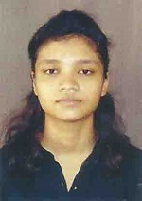

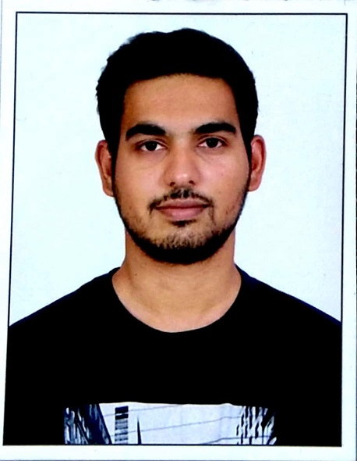
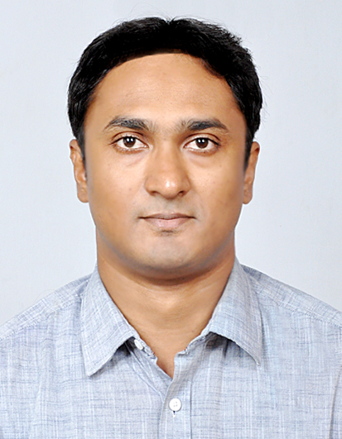
Thank You
Aishwarya Ray, Data Scientist , Kaustav Nag, Data Scientist , Capgemini Meet Jani, Data Scientist IaS Hub
Capgemini.
Anupam Saha, Associate Director (Data Science & AI BU), Cognizant

